Slide 1


Bank Loan Analytics
and
Debit & Credit Transactions
18th February 2026
-Presented by Group 6

Slide 2
Meet Our Team
Syed Imtiyaz
Manas Jena
Mende Sravya
A Yogyatha Bhargavi
Nasiya Fathima N
Chethan Racharla

Slide 3




Tools Used for this project:
Project Management Tools
Excel
Tableau
Mysql
Power BI

Slide 4
Agenda
Introduction
Data Overview
Objectives/Kpi’s
Analysis and Insights
Process
Recommendations and Insights
Conclusion
Report/Dashboard
Challenges and Learnings

Slide 5
BANK LOAN ANALYTICS-INTRODUCTION
Domain: Banking & Financial Services
Business Problem: Increasing loan defaults, rising delinquency rates, and lack of clear visibility into loan performance across regions and customer segments.
Goal: Analyze loan distribution, funding, collections, and customer risk patterns to improve portfolio performance, reduce defaults, and support data-driven decision making.

Slide 6
BANK LOAN ANALYTICS-DATA OVERVIEW
File: bank_loan.csv
Size: 65,535 loan records
Key Columns: Account ID, Loan Status, Loan Amount, Int Rate, Is Delinquent Loan, Disbursement Date(year), Age, Branch Name, Religion, Product Code, Grade
Aggregations(KPI’S): Total Loans: 65K, Total Funded Amount:733M, Total Interest:155M, Total Collection: 808M, Default Loan:1K, Verified Loan:13K, Non-Verified Loan:17K,
Delinquent Clients:7K

Slide 7
Bank loan dashboard-Objectives/kpi’s
Total Loan Amount by Age
Total Loan Amount By Year
Total Loan Amount by Grade
Total Amount by loan Status
Total Loan amount by Religion
Total Loan amount by States
Total Loan amount by Branch(interest, fees)

Slide 8
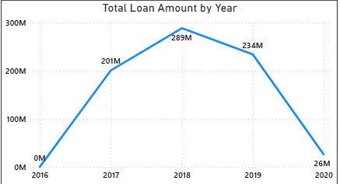
BANK LOAN DASHBOARD-ANALYSIS AND INSIGHTS
Analysis: Yearly Loan Amount
Insights:
2017–2018 marked the strongest growth phase in lending activity.
2018 was the peak year with maximum loan disbursement (₹289M).
Lending slowed in 2019, indicating possible tightening of credit policies or reduced demand. A sharp fall in 2020 suggests external disruption impact (economic slowdown, policy changes, or crisis period).
The bank may need to reassess credit expansion strategy post-2020 to restore portfolio growth.
Overall trend reflects rapid expansion followed by contraction in the later years.

Slide 9
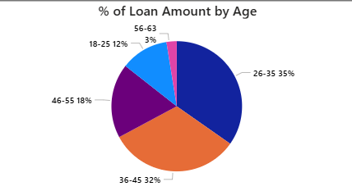
Analysis: Age wise Amount %
Insights:
Loan distribution is highly concentrated in the 26–35 age group (35%), followed closely by 36–45 (32%), showing that mid-career professionals are the primary borrowers.
The 46–55 group (18%) contributes moderately, indicating steady but reduced borrowing as individuals approach later career stages.
The 18–25 segment (12%) has comparatively lower loan share, likely due to lower income levels or early career stages.
The 56–63 group (2%) holds the smallest share, reflecting limited borrowing near retirement age.
Overall, nearly 67% of total loans come from the 26–45 age segment, showing strong dependence on working-age customers.

Slide 10
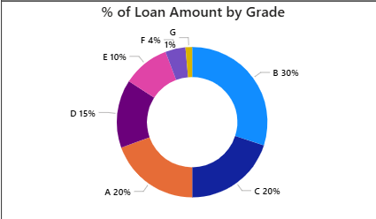
Analysis: Grade wise Amount %
Insights:
The loan portfolio is heavily concentrated in Grade B (30%), making it the largest contributor to total loan disbursement. This indicates a strong focus on mid-quality borrowers, balancing risk and return.
Grade C (20%) and Grade A (20%) follow closely, showing a significant allocation to both moderate and low-risk borrowers. The presence of high funding in Grade A reflects confidence in creditworthy customers.
Grade D (15%) and Grade E (10%) account for a moderate share, suggesting controlled exposure to higher-risk segments.
Grade F (4%) and Grade G (1%) represent the smallest portions of the portfolio, indicating minimal lending to very high-risk categories.

Slide 11
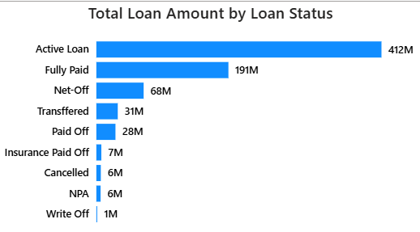
Analysis: Loan status wise amount
Insights:
Active Loans (₹412M) form the majority of the total portfolio, indicating that a large portion of funds is still outstanding — this increases revenue potential but also overall credit risk exposure.
Fully Paid Loans (₹191M) show strong repayment performance, reflecting good credit quality and effective recovery strategies.
Risk-related categories (NPA ₹6M and Write-Off ₹1M) are comparatively very low, suggesting that current loan defaults are under control and portfolio health is stable.
The gap between Active and Fully Paid loans highlights dependency on future repayments, making continuous monitoring of active accounts critical for maintaining portfolio stability.

Slide 12
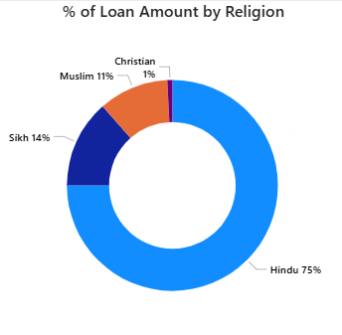
Analysis: Religion Amount %
Insights:
The loan portfolio is largely concentrated within the Hindu segment (75%), accounting for nearly three-fourths of the total loan amount. This indicates a dominant customer base from this group.
The Sikh segment (14%) and Muslim segment (11%) contribute moderate shares, showing meaningful participation but significantly lower compared to the majority segment.
The Christian segment (1%) represents a very small portion of the total loan amount.
Overall distribution indicates high demographic concentration with potential scope for diversification.

Slide 13
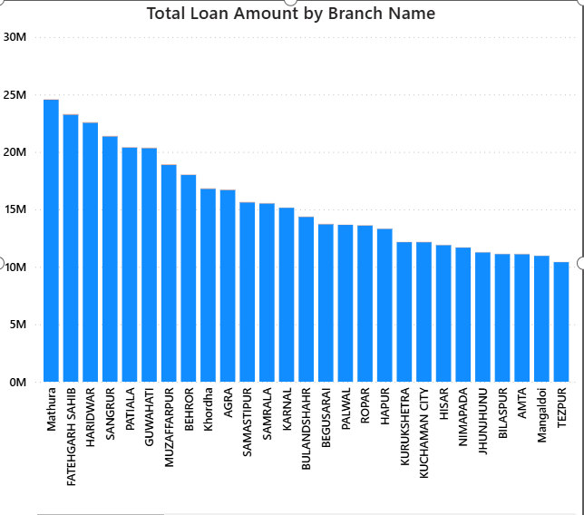
Analysis: Amount by Branch Name
Insights
Mathura records the highest total loan amount, followed by Fatehgarh Sahib and Haridwar indicating strong loan demand and branch performance in these locations.
The top 5 branches (Mathura, Fatehgarh Sahib, Haridwar, Sangrur, Hardoi) contribute a significantly higher share compared to other branches, showing concentration of lending in selected regions.
A gradual decline pattern is visible from highest to lowest branches, suggesting consistent distribution but with moderate performance gaps between branches.
The difference between the highest and lowest branches is ₹15M, highlighting a noticeable regional performance gap and potential opportunity for targeted growth strategies in low-performing areas.

Slide 14
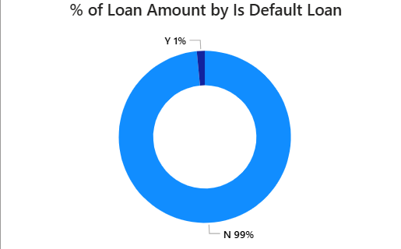
Analysis:% of amount by default loan
Insights:
A significant 99% of the total loan amount falls under Non-Default (N) category, indicating strong overall loan portfolio performance.
Only 1% of the loan amount is classified as Default (Y), showing that the bank maintains a very low default exposure.
The minimal default percentage suggests effective credit risk assessment and borrower screening processes.
The high proportion of non-default loans reflects stable repayment behavior and healthy cash flow management among customers.
Even though the default rate is low, continuous monitoring is essential to prevent future credit risk accumulation.

Slide 15
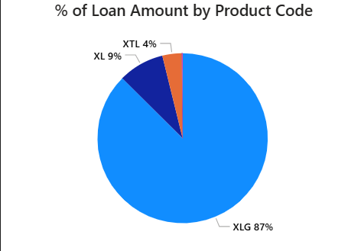
Analysis: % of Amount by Product Code
Insights:
XLG dominates the portfolio with 87% of the total loan amount, indicating that it is the primary and most preferred loan product.
XL contributes 9%, representing a moderate share but significantly lower compared to XLG, suggesting limited demand or targeted usage.
XTL accounts for only 4%, making it the least utilize product among the three.
The heavy concentration in a single product (XLG) indicates portfolio dependency risk, and diversification across XL and XTL products could help balance revenue streams and reduce risk exposure.
Overall, the dashboard highlights strong performance from XLG but also signals the need for product diversification to enhance long-term stability

Slide 16
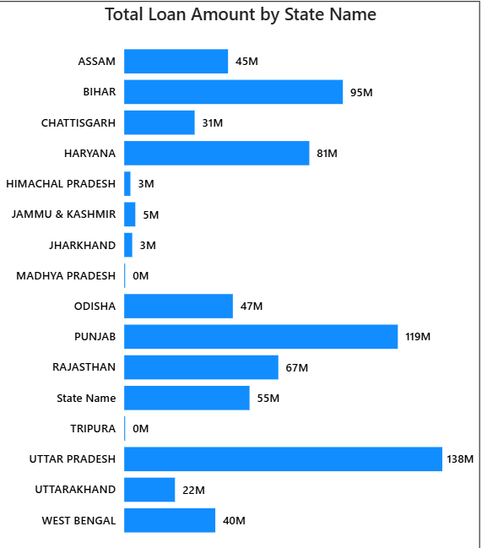
Analysis: Total Amount by State
Insights:
Uttar Pradesh (138M) leads significantly, followed by Punjab (119M) and Bihar (95M), indicating strong regional concentration.
Haryana (81M) and Rajasthan (67M) also show solid contribution to the overall portfolio.
Mid-level performance is seen in Odisha, Assam, West Bengal, and Chhattisgarh.
Very low or zero loan amounts are recorded in Himachal Pradesh, Jharkhand, Jammu & Kashmir, Madhya Pradesh, and Tripura.
Overall distribution suggests high dependency on a few key states with growth potential in underpenetrated regions.

Slide 17
Bank loan analytics-Process
Data Collection
Data Cleaning: Handled null values, removed duplicates
Data Transformation: Created KPIs (Total Loans, Total Loan Amount funded, Total Collection, Total Interest, Default Loan, Verified Loans, Non Verified Loans, Delinquent Clients)
Visualization: Built dashboard using Excel, Tableau, Mysql and Power BI
Insight Extraction

Slide 18
BANK LOAN ANALYTICS-RECOMMENDATIONS & INSIGHTS
66K total loans with ₹808M collections indicate strong repayment performance
• Loan portfolio heavily concentrated in a few states (UP, Punjab, Bihar)
• 26–35 age group contributes highest loan share (34.75%)
• Grade B loans dominate portfolio, reflecting moderate risk exposure
• XLG product accounts for 87% of total loan amount (high product dependency)
• 7K delinquent clients highlight recovery improvement opportunity
• Loan disbursement peaked in 2018 and declined sharply by 2020

Slide 19
BANK LOAN ANALYTICS-CONCLUSION
Conclusion of Analysis:
• The bank maintains a strong loan portfolio with ₹808M total collections exceeding ₹733M funded amount.
• Loan demand is concentrated in the 26–45 age group and a few key states, showing both opportunity and concentration risk.
• Grade B and Active loans dominate the portfolio, indicating moderate but controlled credit risk exposure.
• Delinquent clients (7K) and 1K default loans highlight areas for improved recovery and monitoring.
• Product dependency on XLG (87%) suggests a need for portfolio diversification.
• Strategic focus on credit monitoring, geographic expansion, and product diversification can enhance growth and reduce risk.

Slide 20
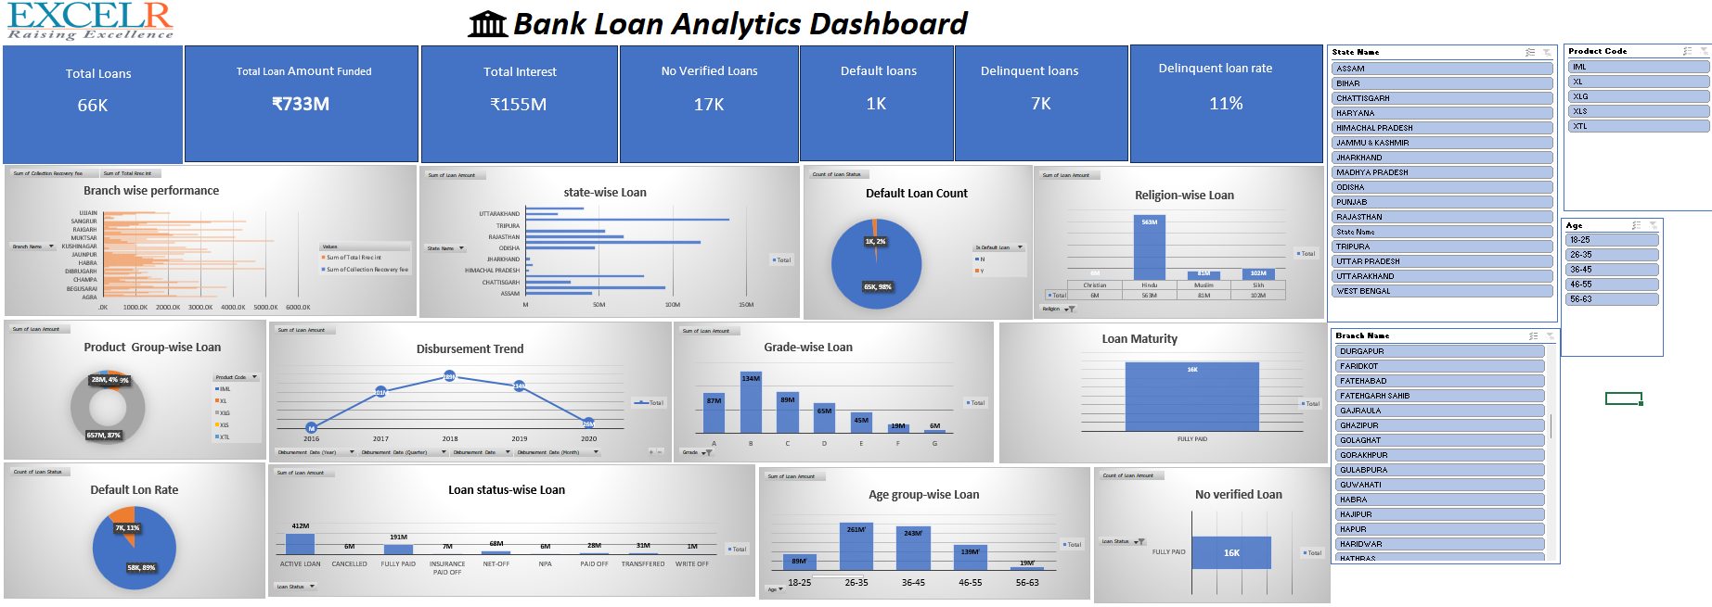
Bank Loan Analytics-Excel Dashboard

Slide 21
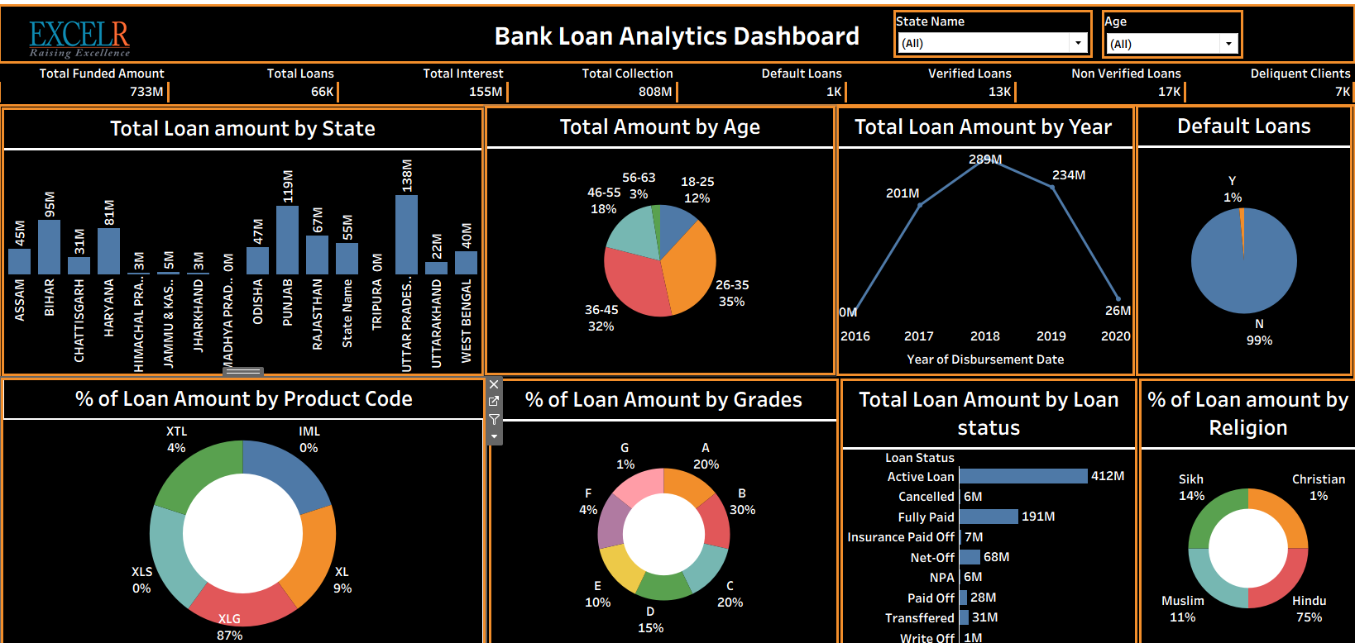
Bank Loan Analytics-Tableau Dashboard

Slide 22
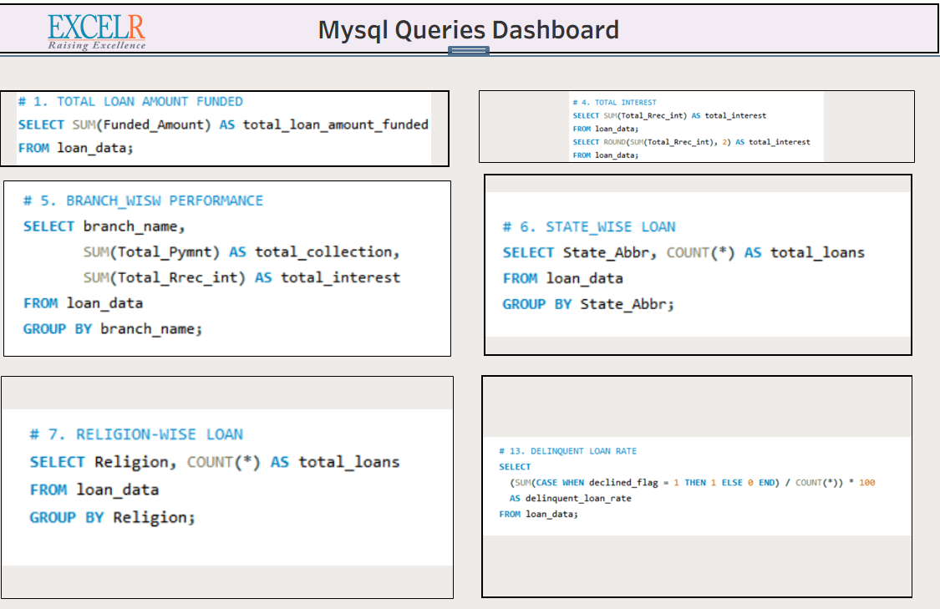
Bank Loan Analytics-Mysql Dashboard

Slide 23
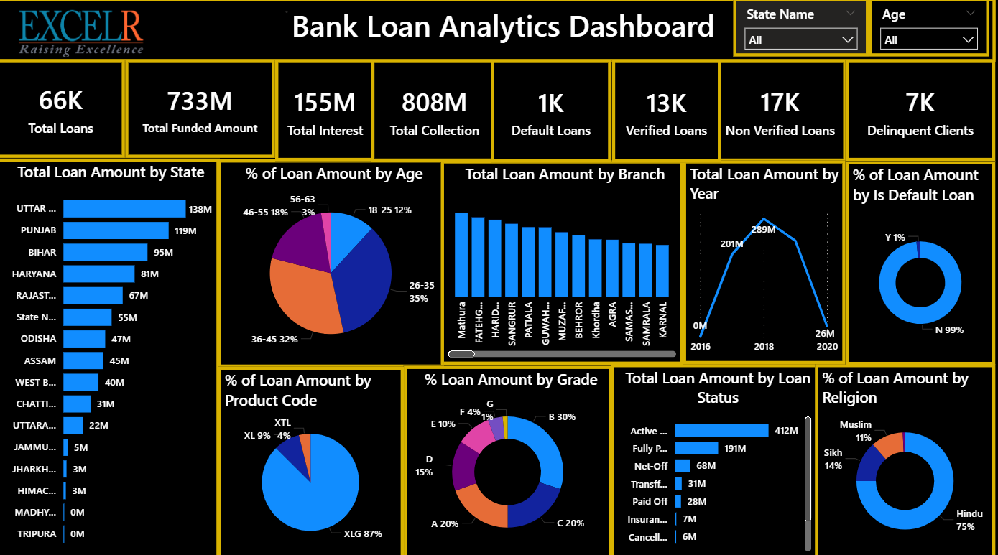
Bank Loan Analytics-Power Bi Dashboard

Slide 24
Debit and credit transactions-introduction
Domain: Banking & Financial Services
Business Problem: Difficulty in monitoring debit and credit transactions effectively, imbalance between credit and debit amounts, and lack of clear visibility on transaction trends across banks, branches, and payment methods.
Goal: Analyze transaction patterns, monitor financial performance, evaluate branch and bank performance, and improve decision-making using key performance indicators such as Credit-to-Debit Ratio and Account Activity Ratio.

Slide 25
DEBIT AND CREDIT TRANSACTIONS-DATA OVERVIEW
Files: transactions.csv
Size: 100,000 of transaction records across all banks and branches
Key Columns: Customer ID, Transaction Date, Bank Name, Branch Name, Transaction Method, Transaction Type (Debit/Credit), Description, Amount, Balance
Aggregations(KPI’S): Total Credit:₹128M, Total Debit:₹127M, Credit-to-Debit Ratio: 1.0025, Net Transactions: ₹318K, Account Activity Ratio: 0.0190%

Slide 26
Debit and credit transactions-Objectives/kpi’s
Total Amount by Year
Total Amount by Description
Total Amount by Transaction Method
Total Amount by Branch Name
Total Amount by Bank Name

Slide 27
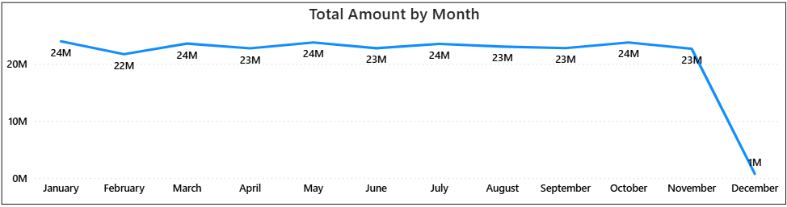
DEBIT & CREDIT TRANSACTIONS-Analysis and Insights
Insights:
From January to November, the total loan amount remains highly stable, fluctuating between ₹22M and ₹24M, indicating consistent lending activity throughout most of the year.
January, March, May, July, and October (₹24M) show slightly higher disbursements, reflecting peak performance months.
The variation across these eleven months is minimal (only ₹2M difference), suggesting strong portfolio stability and steady demand.
A sharp drop is observed in December (₹1M), which is significantly lower than other months and may indicate incomplete data, seasonal slowdown, or reporting cut-off effects.
Analysis: Monthly Transactions

Slide 28
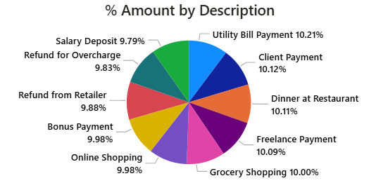
Analysis: Description wise Amount %
Insights:
Utility Bill Payments contribute the highest total amount, followed closely by Client Payments and Restaurant spending.
Transaction values across categories are relatively balanced, with minimal variation.
Both income (salary, freelance, client payments) and expense categories (grocery, dining, online shopping) show steady activity.
Refund-related transactions form a noticeable portion, indicating active transaction corrections.

Slide 29
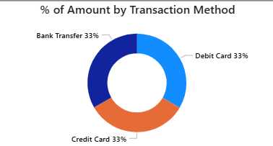
Analysis: Transactions Method %
Insights:
Transaction count is evenly distributed across Bank Transfer, Debit Card, and Credit Card (33% each).
No single payment method dominates, indicating balanced customer preference.
Equal usage suggests diversified payment behavior and strong adoption across all channels.
Provides flexibility for businesses without over-reliance on one transaction mode.

Slide 30
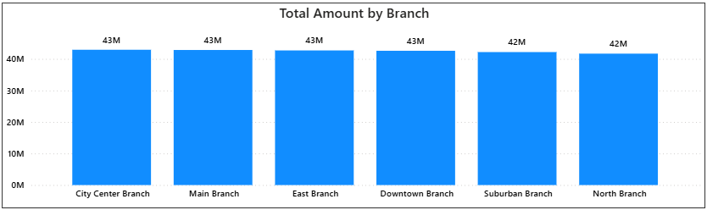
Analysis: Branch wise Transactions
Insights:
Loan amounts are consistently distributed across all branches, ranging between 42M–43M.
City Center, Main, East, and Downtown branches slightly lead at 43M.
Suburban and North branches closely follow at 42M, showing minimal variation.
Overall performance indicates balanced branch contribution with no major outliers.

Slide 31
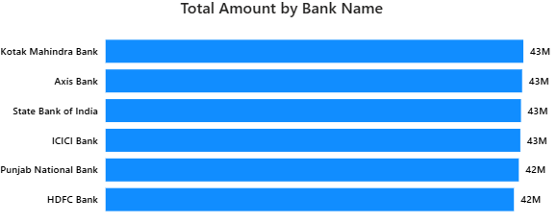
Analysis: Bank wiseTransactions
Insights:
Total amount distribution across banks is highly uniform, ranging between 42M–43M.
Kotak Mahindra Bank, Axis Bank, State Bank of India, and ICICI Bank lead marginally at 43M.
Punjab National Bank and HDFC Bank closely follow at 42M.
No significant performance gap is observed among banks.
Overall, the portfolio appears evenly diversified across banking partners, reducing concentration risk.

Slide 32
Debit & credit transactions-Process
Data Collection
Data Cleaning: Handled null values, removed duplicates
Data Transformation: Created KPIs (Total Credit, Total Debit, Net Transactions, Credit-to-Debit Ratio, Account Activity Ratio)
Visualization: Built dashboard using Excel, Tableau, Mysql and Power BI
Insight Extraction

Slide 33
DEBIT & CREDIT TRANSACTIONS-RECOMMENDATIONS AND INSIGHTS
Credit and Debit amounts are nearly equal, indicating a balanced financial system
• Monthly transactions remain stable with minor seasonal fluctuations
• Transaction methods are equally used across customers
• Branch performance is consistent with minimal variation
• Recommendations: Strengthen marketing during low-activity months and promote digital payment adoption to increase overall transaction volume

Slide 34
DEBIT & CREDIT TRANSACTIONS-CONCLUSION
Conclusion of Analysis:
• Debit and Credit transactions remain balanced throughout the year.
• Monthly transaction trends show consistent performance with minor seasonal variations.
• Bank and branch contributions are evenly distributed with no major performance gaps.
• Diversified transaction methods indicate stable and flexible customer payment behavior.
• Strategic improvements during low-activity periods can further enhance transaction volume and overall financial efficiency.

Slide 35
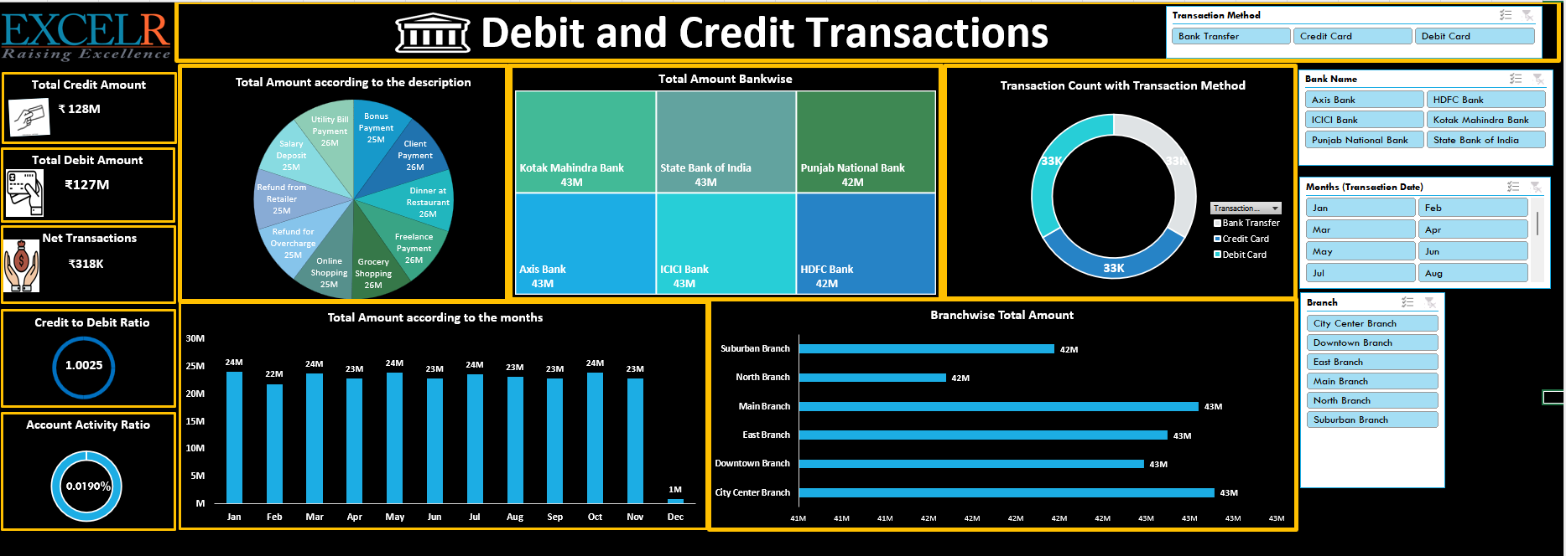
Debit & Credit Transactions-Excel Dashboard

Slide 36
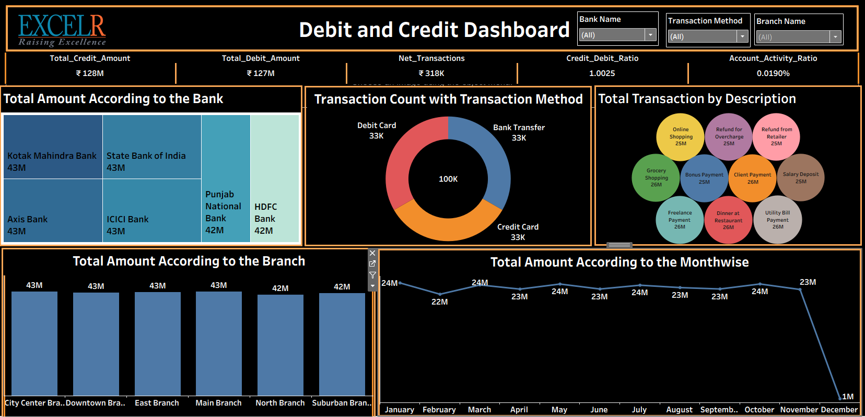
Debit & Credit Transactions-Tableau Dashboard

Slide 37
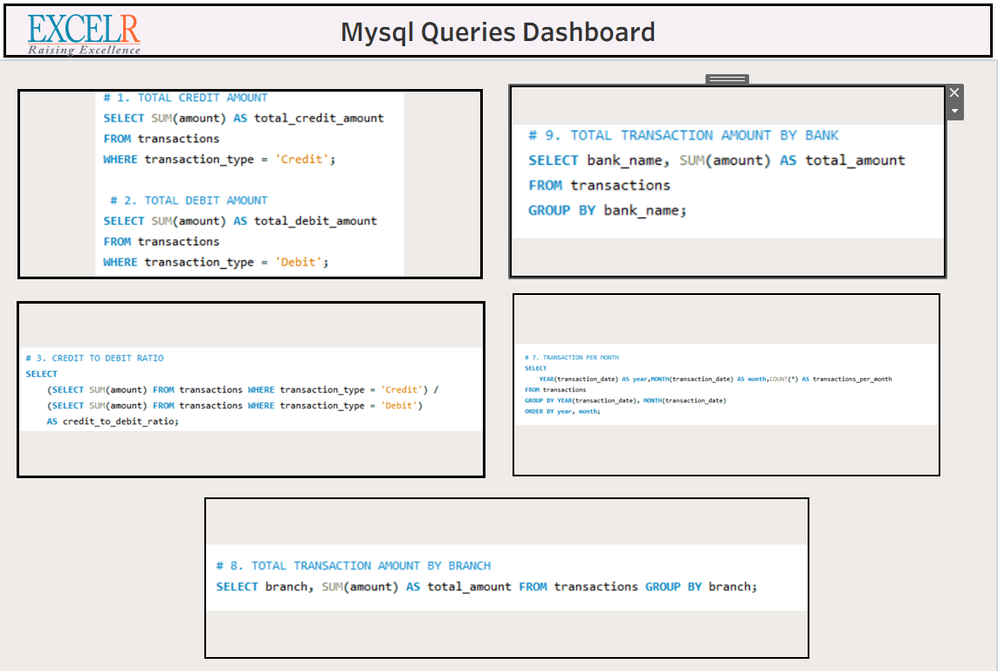
Debit & Credit Transactions-Mysql Dashboard

Slide 38
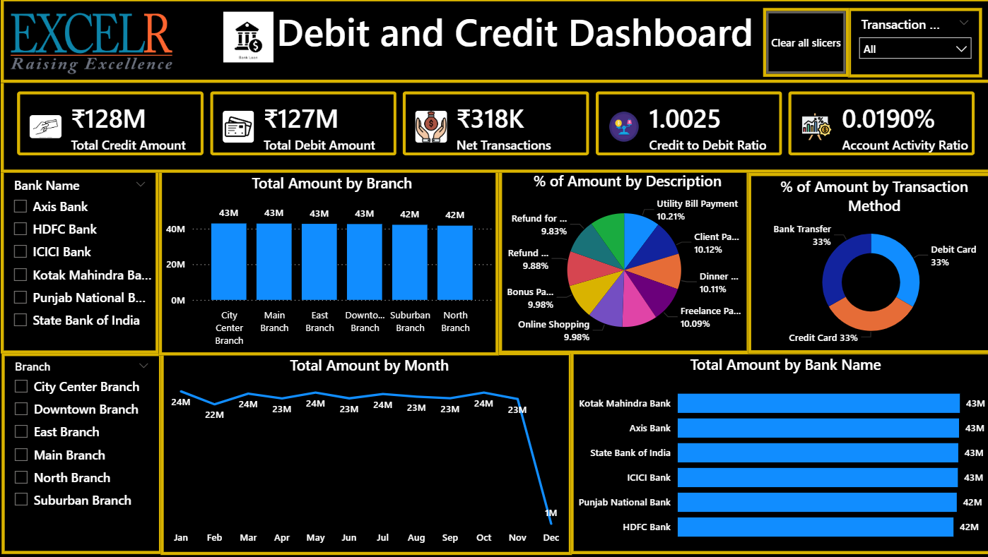
Debit & Credit Transactions-Power Bi Dashboard

Slide 39
Challenges and Learnings
Challenges
Data cleaning & transformation (most time-consuming)
KPI validation with business logic
Maintaining data accuracy across tools
Performance optimization
Dashboard user experience design
Learnings
Importance of Proper Data Modeling
Understanding Filter Context & DAX Logic
Dashboard Design & Visualization Skills

Slide 40
THE END....
-Presented by
Group 6

